Slide 1

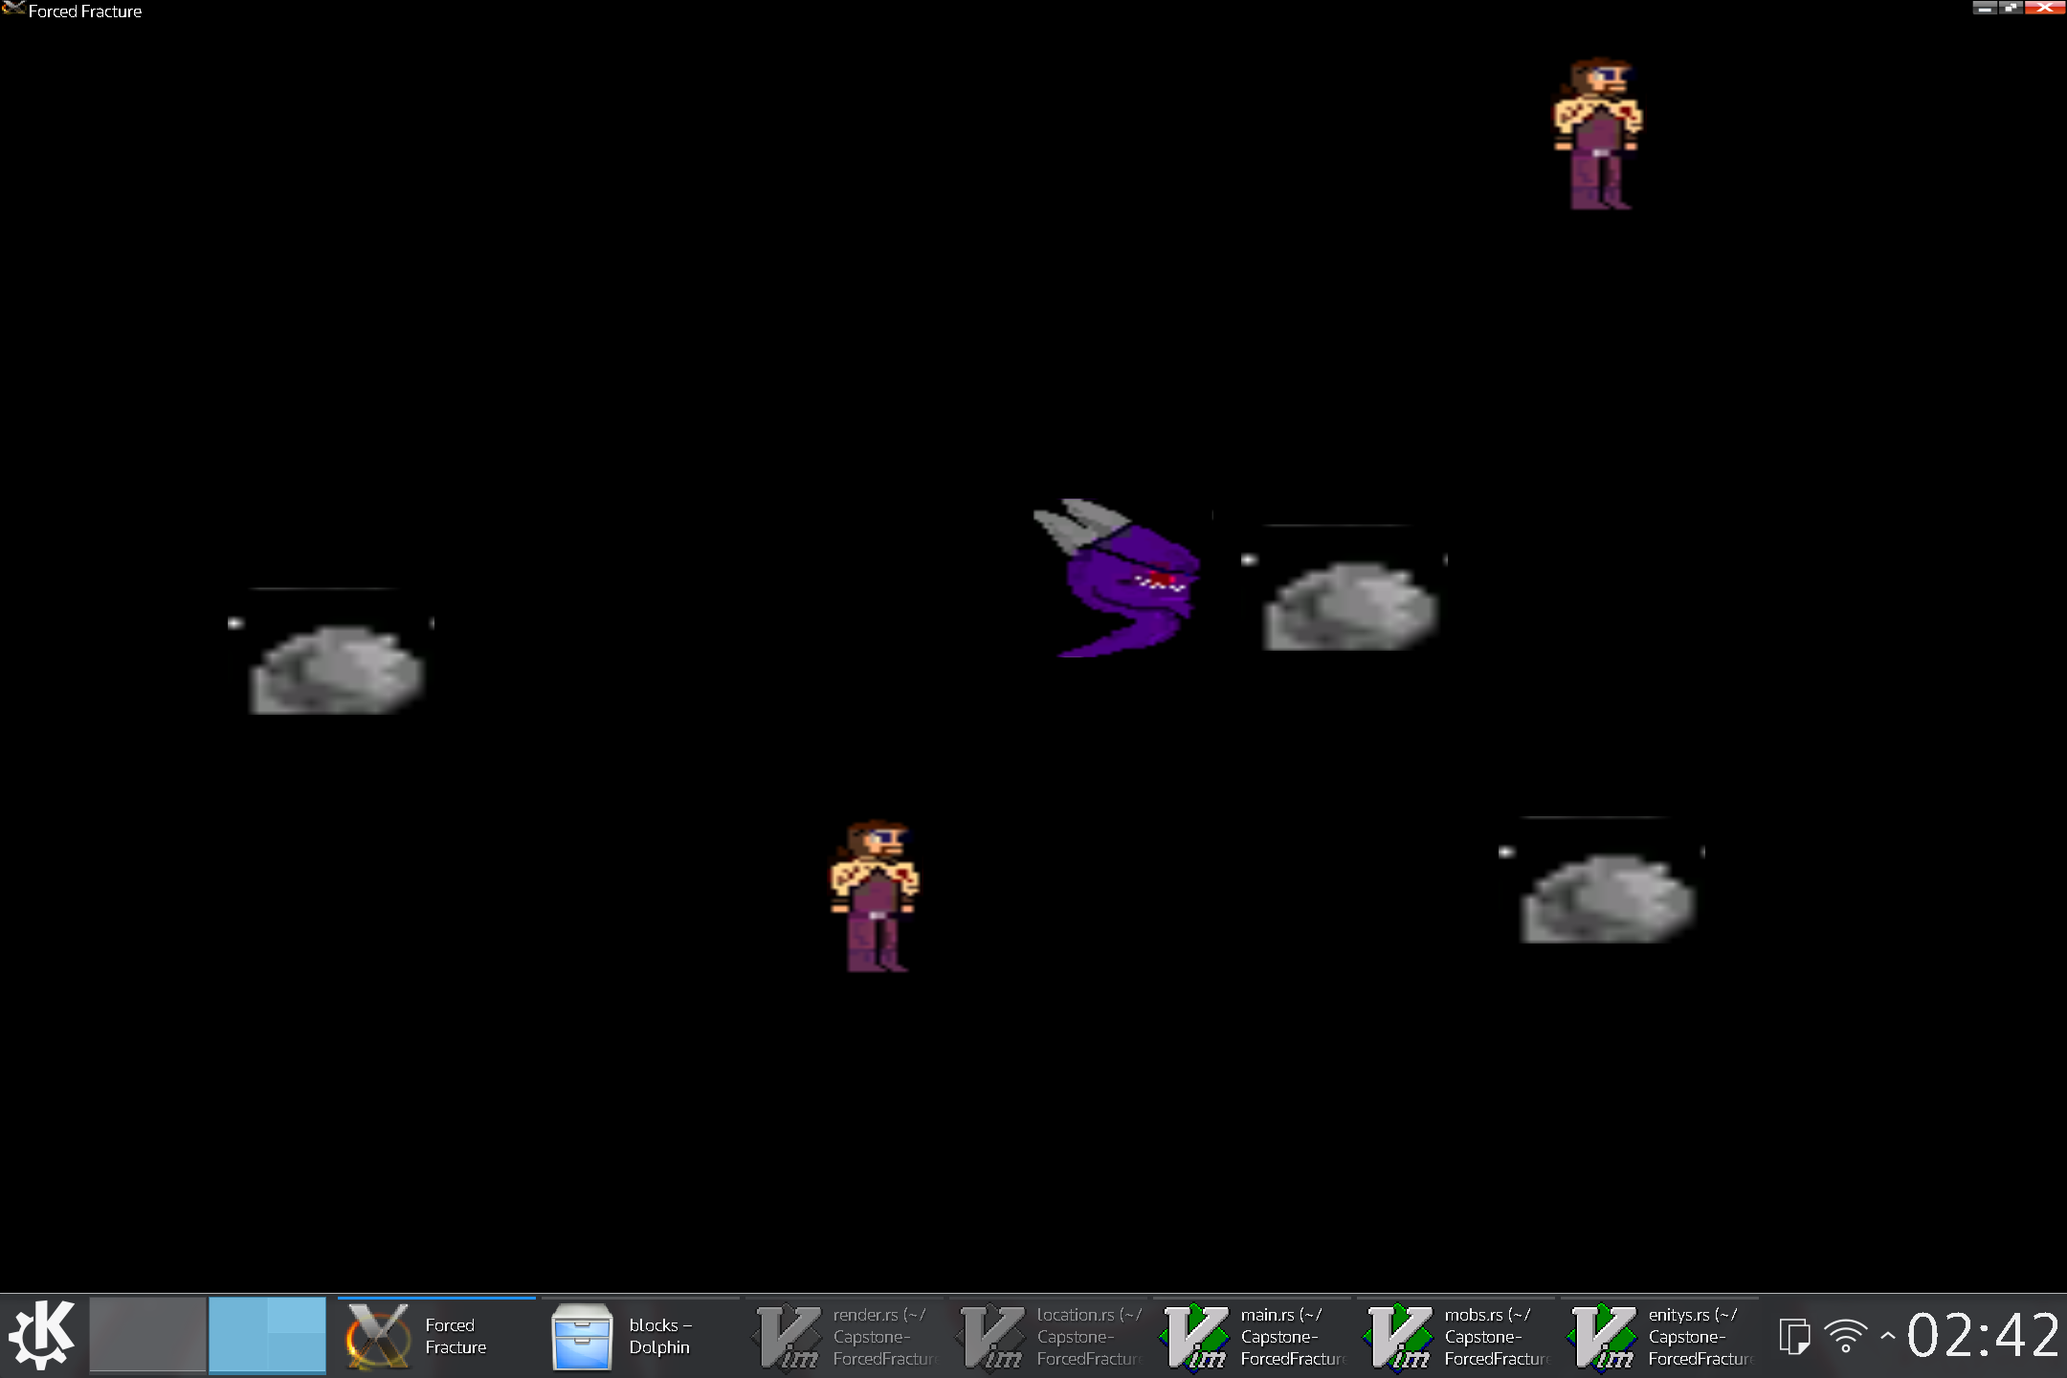
Game Development in the Rust Programing Language
Forced Fracture
By Walter Riley Wolfe
Forced Fracture:
Graphics Driven by OpenGL
Worlds dynamically built at runtime
Uses a flexible component based system, while allowing polynomic systems at the same time.
Benefits of Rust:
Prevents almost any crash
guaranteed memory safety
Fast
zero-cost abstractions
Valued Enums
trait-based generics

